Slide 1
An Introduction to Kubernetes
DevOps Team

Slide 2
Background
“The industry needs to shift from seeing Kubernetes purely as a container orchestrator to leveraging it as an infrastructure abstraction layer.”
Kublr’s CTO - Oleg Chunikhin

Slide 3
Our Pain Point
Too many dependencies between Dev and Ops which slows down our performance.
Ops
Infra Provisioning
Network (Router, Firewall)
Server (Bare metals, VMs)
Database
Storage
Infra Maintenance
O/S Configuration & Upgrade
Package Configuration & Installation
Security Patch
Infra Monitoring
Dev
Application Development
Frontend
Backend
Data Modeling
Application Deployment
DEV/STG/PROD
Application Maintenance
Bug Fixes/Adding New Features
Application Monitoring
Do this …
Done that …
“It is critical to reduce Dev → Ops dependencies! But how?”

Slide 4
The Solution – Infra Abstraction
The basic idea - Let Dev create and manage infrastructure by providing one single large computer.
Ops – we will give you one big machine
10240 CPUs
40960 GB Memory
1 PB SSD
1000 PB HDD
Dev – we will make things whatever we need
Network Components
Router, Firewall, Load Balancer, etc.
Databases
In-Memory DB, RDB, NoSQL, etc.
Storage
SSD, NAS, etc.
Application Servers
Backend, Frontend, etc.
”We manage this big machine.”
”We manage these components.”

Slide 5
The Solution – Infra Isolation
Ops isolates infrastructure for Devs and is responsible for governance.
Dev B – MSA 2
1024 CPUs
1024 GB Memory
20 GB SSD
Ops
10240 CPUs
40960 GB Memory
1 PB SSD
1000 TB HDD
Dev A – MSA 1
100 CPUs
100 GB Memory
10 TB SSD
1 PB HDD
Dev C – MSA 3
10 CPUs
32 GB Memory
100 GB SSD
10 PB HDD

Slide 6
The Big Machine – Kubernetes Cluster
Kubernetes is an infrastructure abstraction layer that can be running on top of a laptop, bare metal servers of on-premise, and any CSPs such as aws, azure and gcp.
Service A
Service B
…
Kubernetes Cluster
Laptop
Bare Metals
VMs
AWS
Azure
GCP

Slide 7
R&R
Kubernetes enables to reduce dev – ops dependencies as much as possible by Infra Abstraction and Isolation.
Service A
Service B
…
For Dev
k8s object definition
Application development
CI/CD
For Ops
k8s cluster provisioning
Governing
Policy management
k8s cluster A
k8s cluster B
…
Underlying Infrastructure (Bare Metals, AWS, etc.)

Slide 8
Dev‘s Point of View
Coding from Server
Coding from Local
Coding using Kubernetes
~ 1999
Access to development server
Coding using VI
Build in server env
Debug in server env
Packaging by creating scripts
Deploying manually vi ftp
2000 ~ 2019
Install WAS → framework in local machine
Coding using IDE
Build in local env
Debug in local env
Deploying manually vi ftp → Jenkins
2019 ~
Install minikube
Coding using IDE
CI/CD from local to prod
I feel like having a small data center in my laptop.
There is no ”localhost” access anymore.

Slide 9
Kubernetes Demo
Delivery Hero Korea This document is strictly confidential and may not be copied, used, made available or be disclosed to third parties without prior written permission.

Slide 10
Logical Architecture (local)
Presentation Layer
Business Layer
Data Layer
Kubernetes Cluster (minikube, namespace=yogiyo)
Ingress
(nginx ctrl.)
Frontend Pod (replica = 2)
Backend Pod (replica = 2)
Redis Pod (replica = 1)
Pod (replica > 2)
Backend Pod (replica >= 2)
Storage Class (hostpath)
nginx
Rest API
L/B
Session Data
http 80
HTML
Django Rest
L/B
CSS, Images
Django
http 8080
Bootstrap
gunicorn
JQuery.js
Postgres Pod (replica = 1)
Storage Class (hostpath)
L/B
nginx
L/B
Relational Data
http 8000

Slide 11
Logical Architecture (prod)
Presentation Layer
Business Layer
Data Layer
Kubernetes Cluster (EKS, namespace=yogiyo)
Ingress
(ALB ctrl.)
Frontend Pod (rep: 2~10)
Backend Pod (rep: 2 ~ 10)
Redis Pod (replica = 1)
Pod (replica > 2)
Backend Pod (replica >= 2)
yogiyo-nuno.click
www.yogiyo-nuno.click
nginx
Rest API
L/B
Session Data
http 80
http 8080
HTML
Django Rest
backend.yogiyo-nuno.click
L/B
CSS, Images
Django
PVC/PV/SC
http 8000
Bootstrap
gunicorn
JQuery.js
Postgres Pod (replica = 1)
L/B
nginx
L/B
Relational Data
External DNS
PVC/PV/SC
aws
Route53
ECR (image registry)
EFS (postgres-efs)
EFS (redis-efs)
A, yogiyo-nuno.click
A, www.yogiyo-nuno.click
A, backend.yogiyo-nuno.click

Slide 12
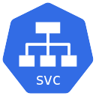

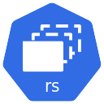
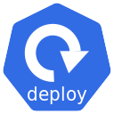
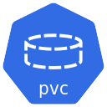
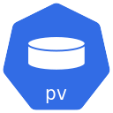


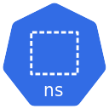
Kubernetes Deployment Diagram
frontend
hostath
redis
yogiyo.com
backend
postgres
hostpath
yogiyo
hostpath

Slide 13







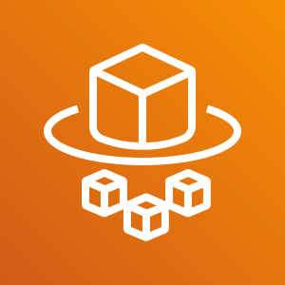

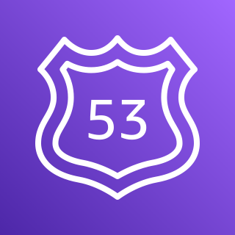

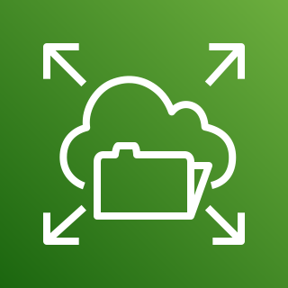
AWS Deployment Diagram
AWS
Seoul Region
VPC
Pods
frontend
backend
redis
postgres
Private subnet
Internet gateway
alb
EKS
Fargate
Users
Route53
ECR
EFS
(redis-efs)
EFS
(postgres-efs)

Slide 14
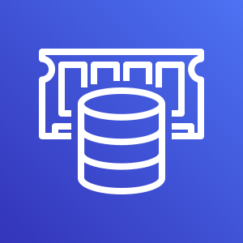
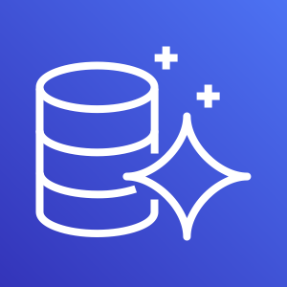
AWS Deployment Diagram
AWS
Seoul Region
VPC
Pods
frontend
backend
Private subnet
Internet gateway
alb
EKS
Fargate
Users
Route53
ECR
ElastiCache
(Redis)
Aurora
(PostgreSQL)

Slide 15
CI/CD Overview
Development
Tagging & Push
Deployment
Visual Studio Code
(development tool)
develop
End Users
commit
Git
(source code repository)
AWS
Ingress
build
EKS
(k8s cluster)
Developers
ECR
(container image registry)
Skaffold
(CI/CD tool)
tagging & push
Pod
Pod
deploy
pull
Pod
Minikube
(k8s single cluster)
test & debug

Slide 16






Key Points
Serverless
There is no dedicated EC2 and fixed IP address. Therefore, no security patch, no O/S upgrade, etc. are required.
Cost Saving
No cost optimization is required. We only pay for what we use based on CPU/memory usage.
Dev Env
No Dev environment is required for frontend developer. Dev is for the integration test between MSAs.
CI/CD
Simple yet powerful CI/CD for both application and infrastructure.
Throttling
Safe
No 402-throttling issue unlike Lambda.

Slide 17

THANK YOU
Delivery Hero Korea This document is strictly confidential and may not be copied, used, made available or be disclosed to third parties without prior written permission.

